Slide 1
Vertex Cover
Soham Chakraborty
22CS02002

Slide 2

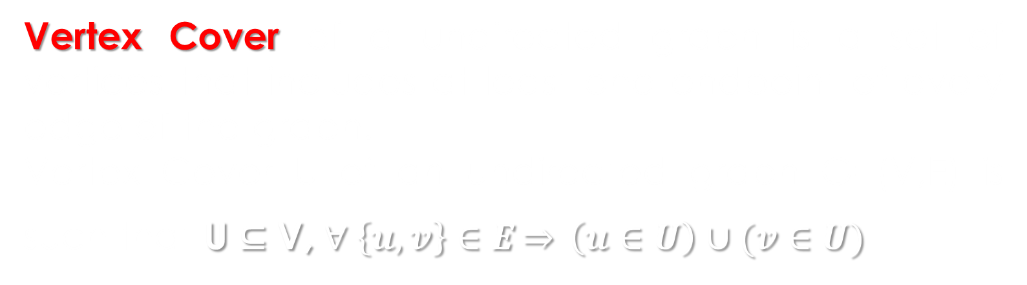
Definition
Vertex Cover of a undirected graph is a set of vertices that includes at least one endpoint of every edge of the graph.
Vertex Cover U of an undirected graph G=(V,E) is such that U ⊆ V, $∀ \left\{u,v\right\}∈E\underset{⇒}{} \left(u∈U\right)∪(v∈U)$
Vertex Cover Problem is the problem of finding if there exists a Vertex Cover of size $≤$ k.
Minmum Vertex Cover Problem is the problem of finding the Vertex Cover with minimum size.

Slide 3
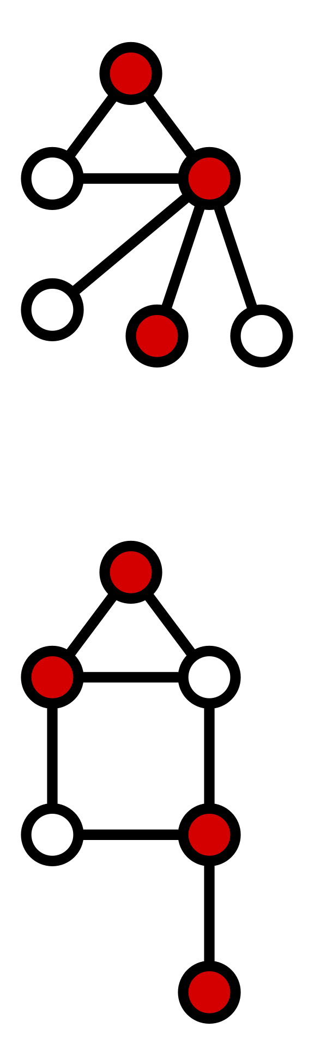
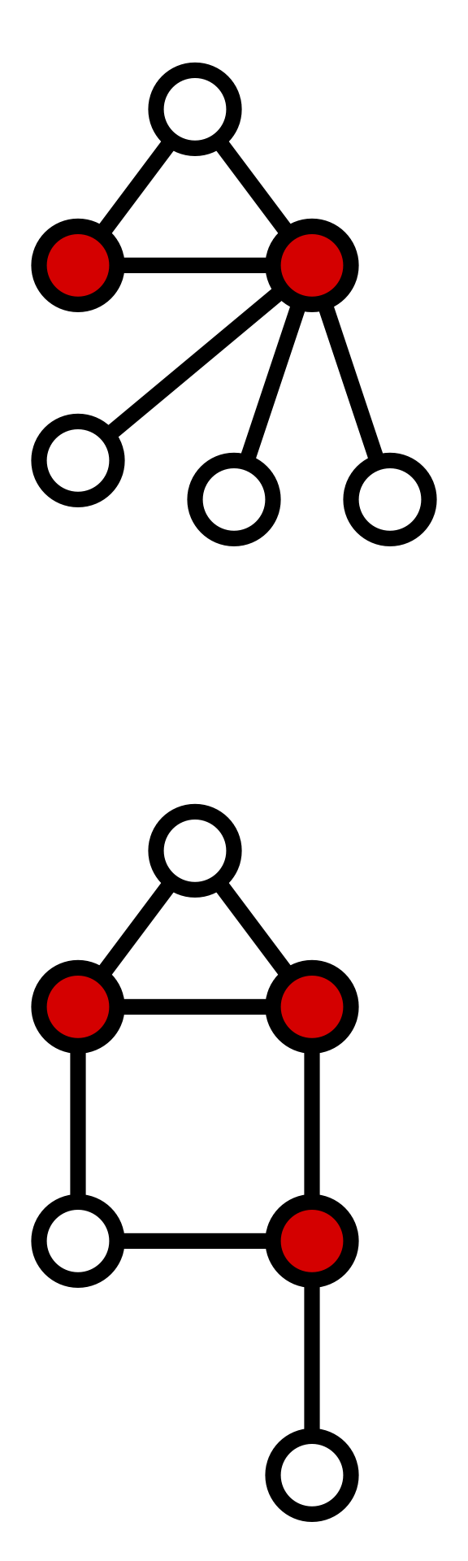
Example
Vertex Cover Minimum Vertex Cover

Slide 4
NP-Completeness
A problem T is called NP-complete if:
T is NP, i.e. the candidate solution to T can be verified in polynomial time.
T is NP-Hard i.e. every problem in NP can be reduced to T in polynomial time.
Cook-Levin Theorem: It states that SAT(Boolean-Satisfiability Problem) is NP-Complete and any problem in NP can be reduced to SAT in polynomial time.
Most commonly known are Karp's 21 NP-Complete problems.
Example: 3-SAT, Vertex Cover Problem, 0-1 ILP, Knapsack.

Slide 5
Proof of Vertex Cover is NP-Complete
To show that Vertex Cover is NP-Complete we need to show that is:
1. NP
For a given solution to vertex cover, it is verifiable in linear time if the candidate solution is satisfiable or not by going through all the edges connected to the vertices in Vertex Cover and ensuring all the edges at covered at least once.
2. NP-Hard
To show it is NP-hard we can either directly use the Cook- Levin theorem and start from SAT or 3-SAT problem, or, we can use a previously known NP-Complete problem for this.
Here, the Clique Problem is used which is shown to be NP- Complete from the 3-SAT problem.

Slide 6

Consider the undirected graph G=(V,E). Let there be clique consisting of vertices C ⊆ V, such that |C|= k.
Complement graph G^{c} = K_{|V|} \ G. = (V,E^{c})
$\left(u∈C\right)∩\left(v∈C\right)$ $\underset{⇒}{} \left\{u,v\right\}∈E$
$∴∀ \left\{u,v\right\}∈$E^{c}$\underset{⇒}{} \left(u∈(V\backslash C)\right)∪(v∈(V\backslash C))$
From this we can say that $\left(V\backslash C\right)$ is a Vertex Cover of size |V|- k for G^{c}.
Hence, if there exists a clique of size k in G, then there has to exist a Vertex cover of size |V|- k in G^{c}.
Also, if there exists a Vertex Cover U, |U|= k, for G, then there will be a clique of size |V|- k in G^{c}.
Thus, Clique problem can be reduced to Vertex Cover problem and hence Vertex Cover Problem is proven to be NP-Hard and consequently NP-Complete.

Slide 7
Minimum Vertex Cover Optimization Problem is a NP-Hard problem and can be found out from the Vertex Cover Decision Problem by applying binary search on the size of Vertex Cover and thus finding out the Minimum possible size of Vertex Cover

Slide 8
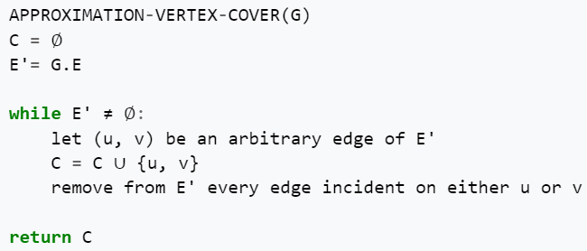
Approximation Algorithm
Since finding an exact optimal solution to Minimum Vertex Cover is very expensive w.r.t time, hence, we use Approximations to find a solution that is close to the optimal solution in comparatively much less time O(V+E).
Given is the Pseudocode for one such approximation:-
Fanica Gavril
and
Mihalis Yannakakis

Slide 9
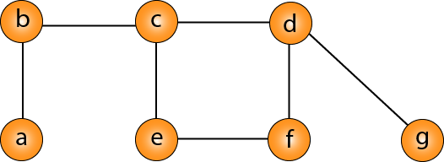
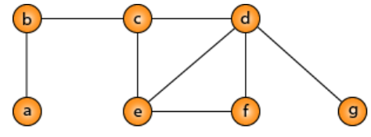

Slide 10
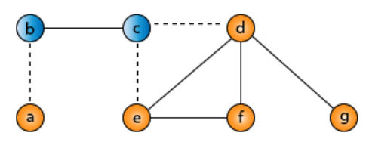

Slide 11
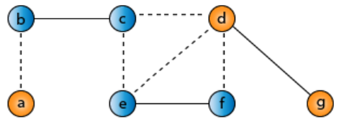

Slide 12
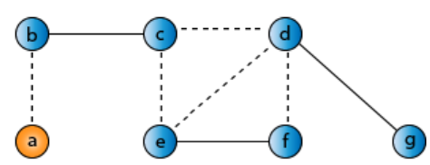
Approximate Solution - 6

Slide 13
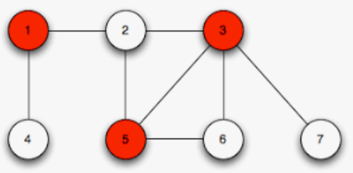
Optimal Solution - 3

Slide 14
The set of edges chosen is a maximal matching of the graph
This Approximate solution always has an approximation ratio ρ(n) = 2. That is the optimal answer is always less than or equal to twice the Approximate Solution. Proof
It is shown that ρ(n) ≥ √2 for any Polynomial Time Approximation and the Approximation cannot be improved further unless P=NP.
[Dinur and Safra, 2005]

Slide 15

Linear Programming
Minimum Vertex Cover can be formulated as an Integer Linear Program (ILP) [ 0-1 LP] as follows:
Minimize:
z = $∑{w\left(u\right)∙x}_{u} , u∈V$ [ Objective function ]
Subject to:
$x_{u}+x_{v}≥1$, $∀ \left\{u,v\right\}∈E$ [ Constraints ]
$x_{u}∈\{0,1\}$, $∀ u$
Here, in this case, $w\left(u\right)=1, ∀ u$
Using this we can also solve another variant of Vertex Cover i.e. the Weighted Vertex Cover where each vertex has unequal weight w(u).
Branch and Bound can be used to solve such LP.

Slide 16
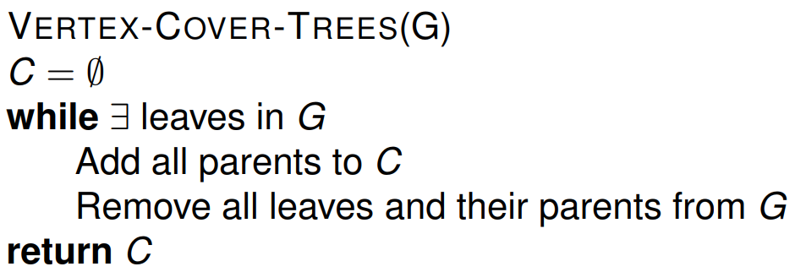
Vertex Cover on Trees
For trees, Minimum Vertex Cover can be exactly solved O(V), by taking all parents of leaves an deleting the leaves and the chosen parents and continuing this further.
Pseudocode:
Example shown below:

Slide 17
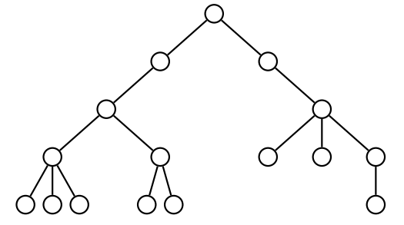

Slide 18
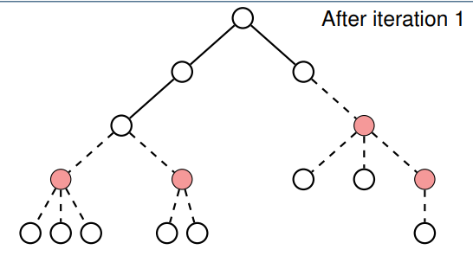

Slide 19
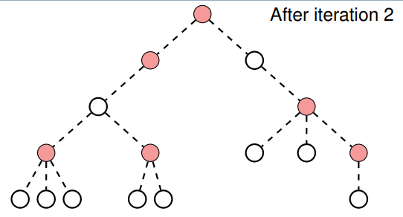
Minimum Vertex Cover: 6

Slide 20
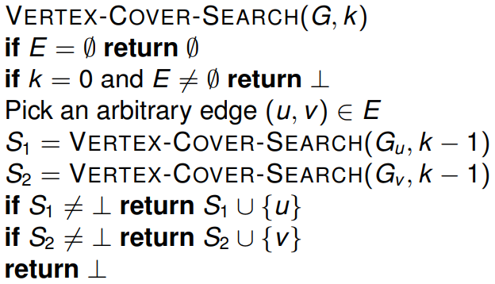
Other Known Results
The best known time for solving Vertex Cover is O(1.3^{k} + n.k)
For Bipartite graphs (including Trees) there exists a polynomial time solution for finding Exact Solution to Vertex Cover O(E√V), using the Kőnig's theorem.
( For Bipartite Graphs- min. Vertex Cover = max. Matching )
A simpler general exact solution exists in O(2^{k}.E):-

Slide 21
Vertex Cover Problem in Real Life
Commercial establishment in installing the fewest possible closed circuit cameras covering all the hallways connecting all rooms on that.
Vertex Cover has applications in DNA sequencing, SNP(Single Nucleotide Processing) and computer network security in the propagation of stealth worms.
Understanding vertex cover and finding efficient solutions to it helps to understand more generalized versions of it such as the set cover.

Slide 22
References
https://www.cl.cam.ac.uk/teaching/1920/AdvAlgo/vertexcover_handout.pdf
https://www.geeksforgeeks.org/introduction-and-approximate-solution-for-vertex-cover-problem/
https://en.wikipedia.org/wiki/Vertex_cover
https://en.wikipedia.org/wiki/Karp%27s_21_NP-complete_problems
https://www.geeksforgeeks.org/proof-that-vertex-cover-is-np-complete/
https://www.javatpoint.com/daa-approximation-algorithm-vertex-cover
https://www.personal.kent.edu/~rmuhamma/Algorithms/MyAlgorithms/AproxAlgor/vertexCover.htm
https://www.dharwadker.org/pirzada/applications/
https://www.youtube.com/
https://en.wikipedia.org/wiki/K%C5%91nig%27s_theorem_(graph_theory)
https://en.wikipedia.org/wiki/NP-completeness
https://en.wikipedia.org/wiki/Clique_(graph_theory)
https://en.wikipedia.org/wiki/Cook%E2%80%93Levin_theorem
https://www.geeksforgeeks.org/proof-that-clique-decision-problem-is-np-complete/

Slide 23
Thank You

